Slide 1

LEARNING
WEEK 2
BY: AQSA FAYYAZ
LECTURER
(SCIENCE AND HUMANITIES)

Slide 2

WHAT IS LEARNING?
HOW IT TAKES PLACE?
WHAT ARE THE WAYS LEARNING IS HAPPENING?

Slide 3
LEARNING OUTCOMES
Define learning
Recognize and define three basic forms of learning—classical conditioning, operant conditioning, and observational learning

Slide 4

Learning
Learning is the act of acquiring new or modifying existing knowledge, behaviors, skills, values, or preferences and may involve synthesizing different types of information.
It is a relative permanent change in behavior or mental state based on experience.
Learning may occur consciously or unconsciously.

Slide 5
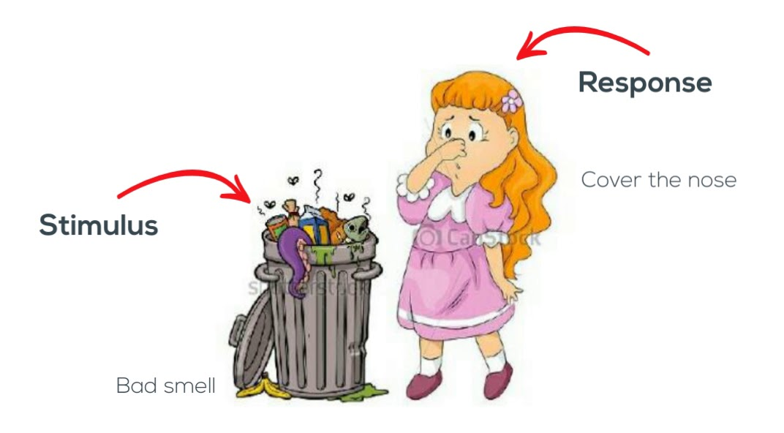
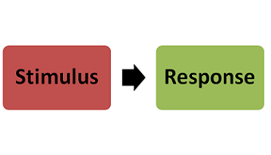
STIMULUS – it is a external and internal change which generate the response of the body.
Any event, any object that triggers a sensory or behavioral response in an organism
RESPONSE – reaction or response shown by the organism.

Slide 6
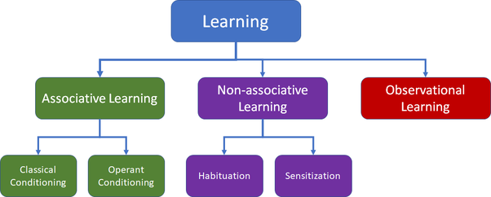
LEARNING

Slide 7
I. Non-associative Learning
Non-associative Learning – is learning that does not require linking or associating stimuli together.
It is the simplest form of learning.
(Habituation, Sensitization).

Slide 8
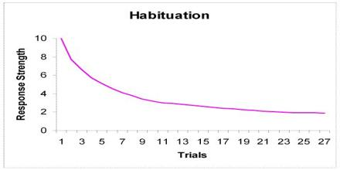
Habituation
Habituation: it is when repeated exposure to a stimulus decreases an organism's responsiveness to the stimulus known as habituation.

Slide 9

For example: 1. The sound of a horn might startle you when you first hear it. But if the horn toots repeatedly in a short time, the amount that you are startled by each sound progressively decreases.
2. Living near the train tracks
3. We don’t respond to the noise outside the classroom when
we repeatedly hear it for long time.

Slide 10
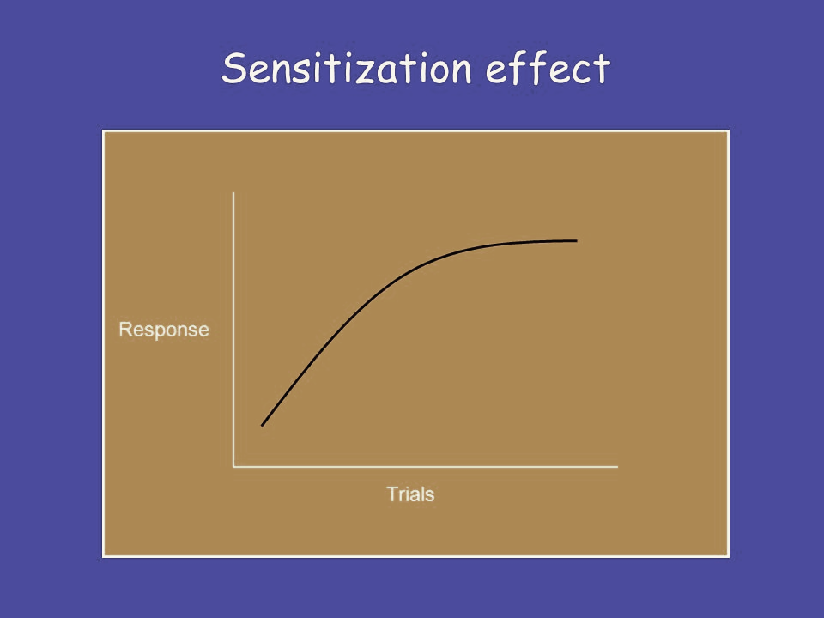
Sensitization
Sensitization: : It is learning that occurs when stimulus is repeated, and each time your response to it increases as it goes on and on.
sensitization occurs when repeated exposure or a single exposure to a stimulus increases the intensity of the response.
For example: 1. the acoustic startle response to a horn is greatly enhanced if you enter a dark alley right before the loud sound.
2. if you are walking down the hall right after watching a scary movie and your friend pops out and says BOO! you will startle more easily. The movie sensitized you. It sensitized you to other stimuli and it did so in one presentation!

Slide 11
11. Associative Learning
Associative learning: is the process by which an association between two stimuli is involved.
It involves the presence of paired stimuli in order for change to occur.
Learning about the relationship between two separate stimuli.
(Classical Learning, Operant Learning)

Slide 12
Important terminology
CONDITIONED – learned
UNCONDITIONED -unlearned

Slide 13
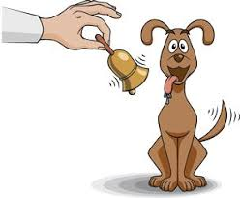
Classical Conditioning
Classical Conditioning – Pavlovian” or “Respondent Conditioning”.
First described by Ivan Pavlov, a Russian physiologist.
"Focuses on involuntary, automatic behaviors/responses”.
Two stimuli are linked together to produce a new learned response in a person or animal.
This learning process creates a conditioned response through associations between an Unconditioned stimulus (US) and a Neutral stimulus (NS).

Slide 14
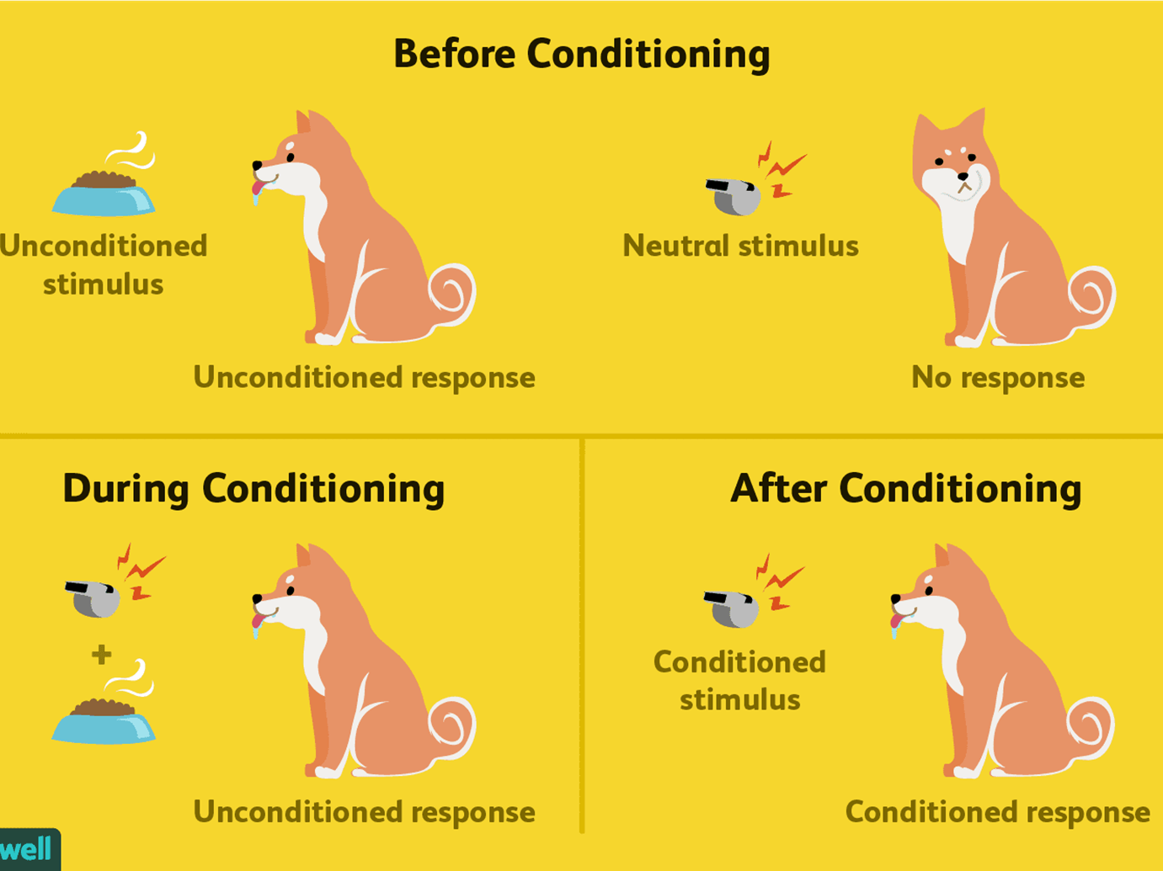
Pavlov’s Dog Experiment:
Phase 1: Before Conditioning
The first part of the classical conditioning process requires a naturally occurring stimulus that will automatically elicit a response.
Presenting food (the UCS) naturally and automatically triggers a salivation response (the UCR).
UCS----------------------UCR

Slide 15
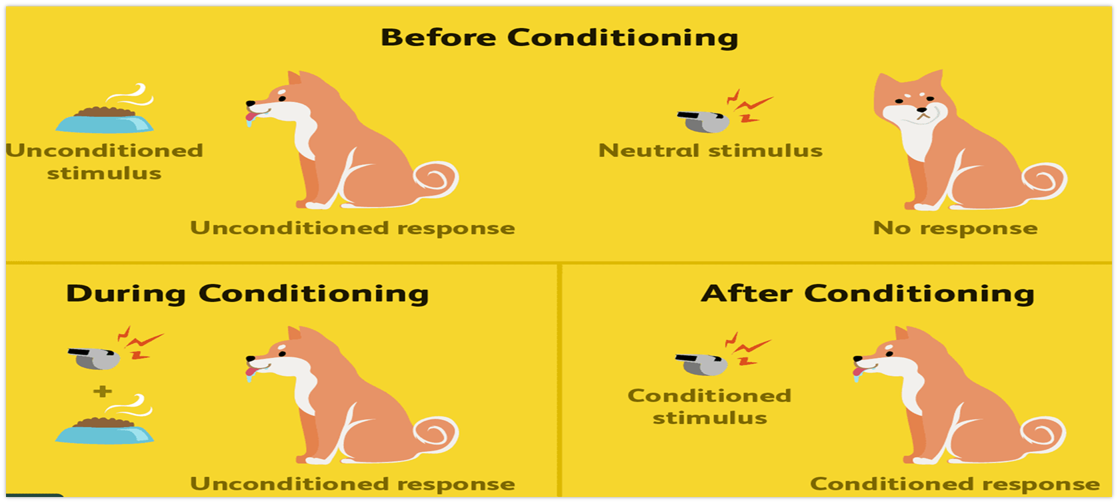
Phase 2: During Conditioning
During the second phase of the classical conditioning process, the previously neutral stimulus is repeatedly paired with the unconditioned stimulus. As a result of this pairing, an association between the previously neutral stimulus(bell ring) and the UCS (food) is formed.
Eventually, the neutral stimulus becomes the conditioned stimulus. (bell ring)
UCS+NS----------------------UCR

Slide 16
Phase 3: After Conditioning
Once the association has been made between the UCS and the CS, presenting the conditioned stimulus alone will come to evoke a response. i.e.: CR (SALIVATION).
In the after conditioning phase, the conditioned stimulus alone triggers the conditioned response.
CS------------------CR

Slide 17
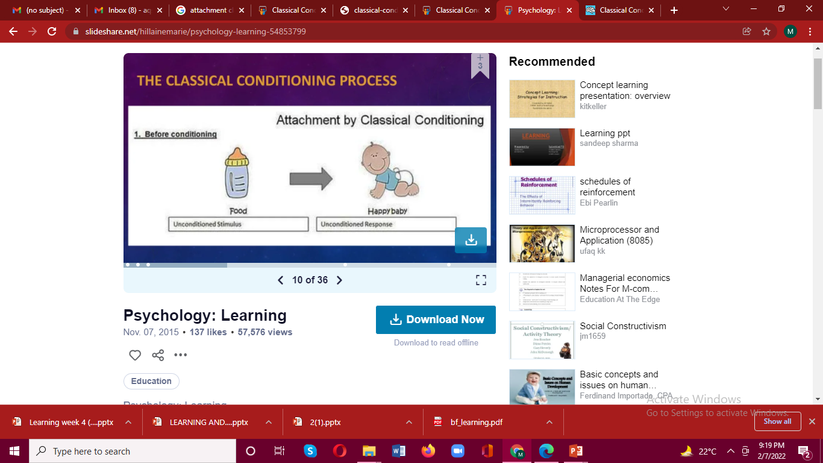
Stage 1: Before Conditioning
The Unconditioned Stimulus (UCS):
The unconditioned stimulus is one that unconditionally, naturally, and automatically triggers a response.
The Unconditioned Response (UCR):
The unconditioned response is the unlearned response that occurs naturally in response to the unconditioned stimulus.

Slide 18
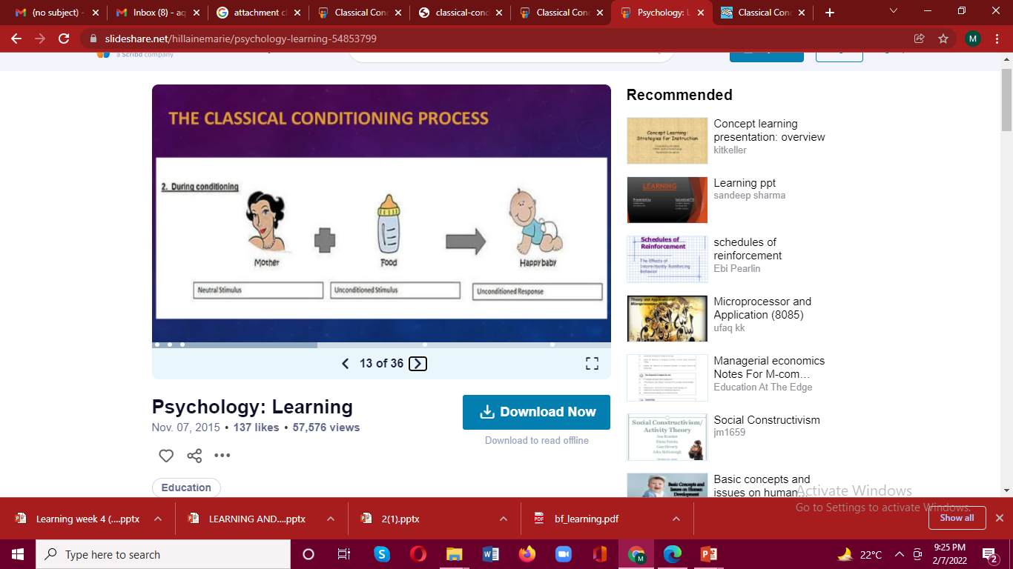
Stage 2 During Conditioning
The Neutral Stimulus
Another stimulus which has no affect on a person.
It could be a person, object, place etc.
The NS in classical conditioning does not produce a response until it is paired with the unconditioned stimulus.
The Conditioned Stimulus
The conditioned stimulus is previously neutral stimulus that, after becoming associated with the unconditioned stimulus, eventually comes to trigger a conditioned response.

Slide 19
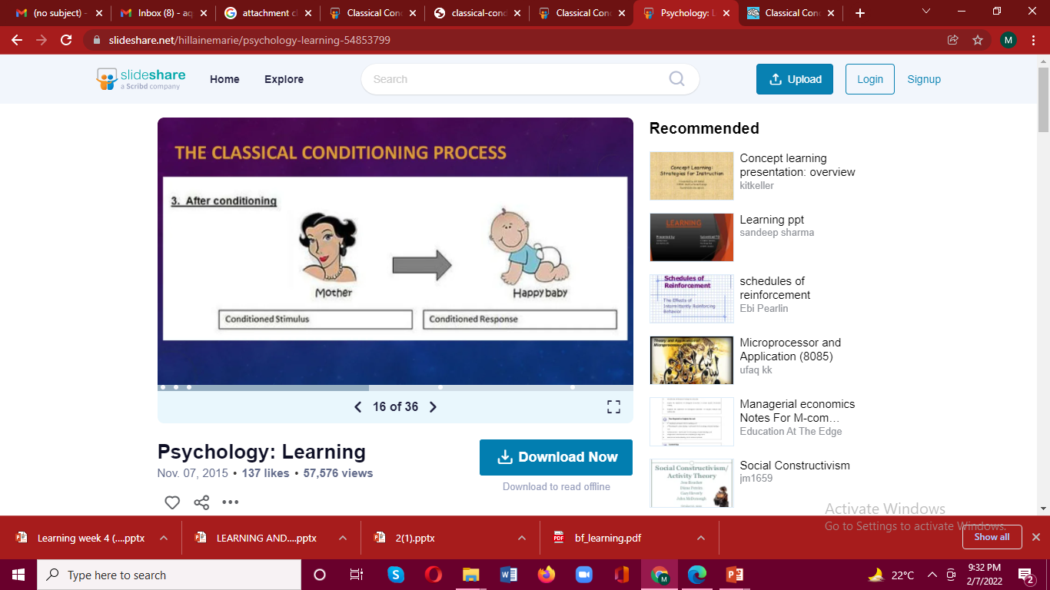
Stage 3 : After Conditioning
The Conditioned Response
The conditioned response is the learned response to the previously neutral stimulus.

Slide 20
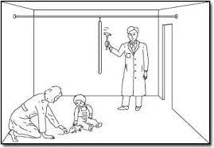
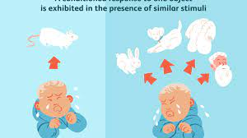
Watson’s work with little Albert
Little Albert was an infant (11 months old), who was conditioned to fear white rats.
Initially when he was exposed to the white rat, little Albert would approach it and play with it. After awhile, when little Albert tried to touch the rat, a loud noise (US) was created which would startle little Albert and cause him to cry (unconditioned response –UR).
After the continuous association of the white rat and loud noise, Little Albert was classically conditioned to experience fear at the sight of the rat.
Albert's fear generalized to other stimuli that were similar to the rat, including a fur coat, some cotton wool, and a Father Christmas mask.
Notes:
https://www.simplypsychology.org/little-albert.html

Slide 21
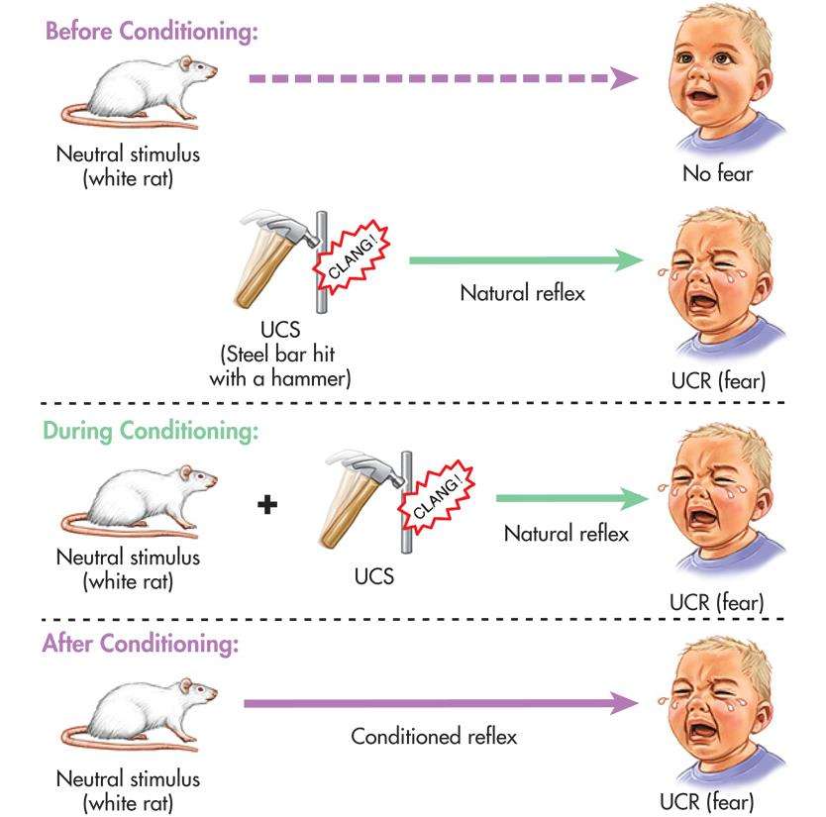

Slide 22
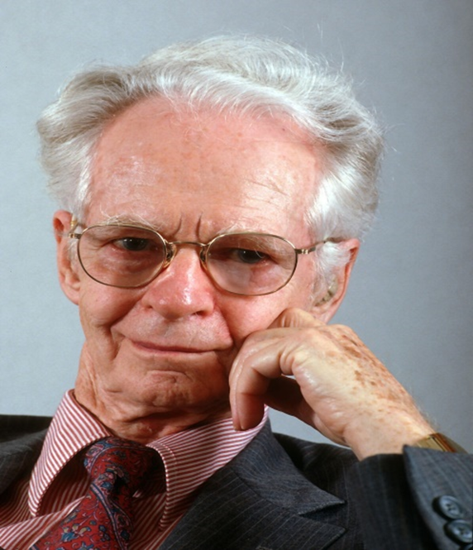
11.Operant Conditioning - Instrumental Conditioning
First described by B. F. Skinner, an American Psychologist
Specific consequences are associated with a voluntary behavior.
It is a learning process in which behavior is sensitive to, or controlled by its consequences.
OR
It is a type of learning in which behavior is strengthened if followed by reinforcement or diminished if followed by punishment.
Involves applying reinforcement or punishment after a behavior.
Notes:
https://blog.cognifit.com/en/b-f-skinner-experiments/

Slide 23
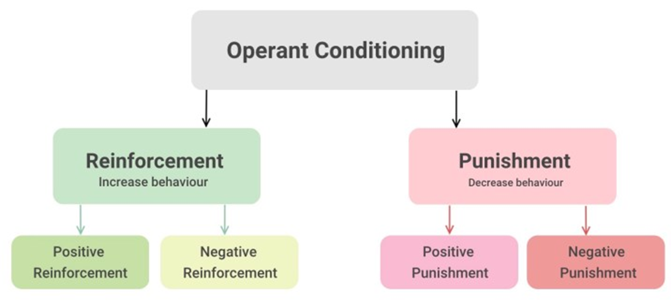

Slide 24
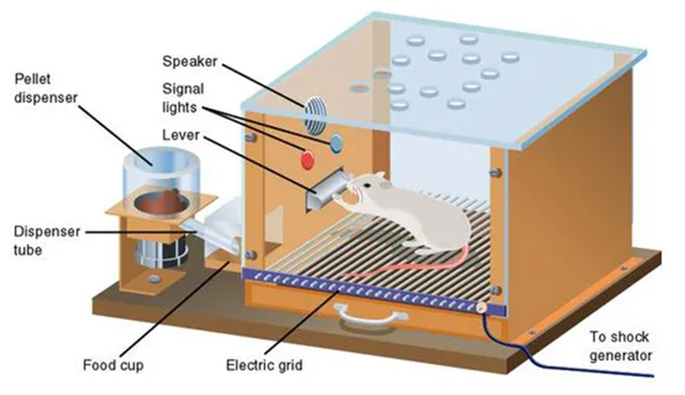
Skinner Box
The "Skinner box" device was a chamber that contained a bar or key that an animal could press in order to receive food, water, or some other form of reinforcement.
A Skinner box, also known as an operant conditioning chamber, is a device used to objectively record an animal's behavior in a compressed time frame.
An animal can be rewarded or punished for engaging in certain behaviors, such as lever pressing (for rats) or key pecking (for pigeons).

Slide 25
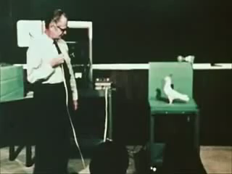
Stimulus: Light bulb
Response/Behavior: Peck on the key
Reward: food
“Pecking behavior is being rewarded.
-Now the pigeon will respond on the light bulb to peck on the key”
Pecking behavior is strengthened.

Slide 26
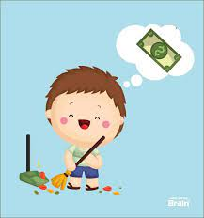
COMPONENTS OF OPERANT CONDITIONING
Reinforcement is any event that strengthens or increases the likelihood of behavior it follows. (Positive Reinforcers, Negative Reinforcers)
In both of these cases of reinforcement, the behavior increases.
Reinforcement is used to help increase the probability that a specific behavior will occur in the future by delivering or removing a stimulus immediately after a behavior.
Another way to put it is that reinforcement, if done correctly, results in a behavior occurring more frequently in the future.

Slide 27
Positive reinforcement
Negative reinforcement
Positive reinforcement presenting a motivating/reinforcing stimulus to the person after the desired behavior is exhibited, making the behavior more likely to happen in the future. In situations that reflect positive reinforcement, a response or behavior is strengthened by the addition of something, such as praise or a direct reward.
For example: 1. A mother gives her son praise (positive stimulus) for doing homework (behavior).
2. The little boy receives gifts (positive stimulus) for every A he earns on his report card (behavior).
Negative reinforcers involve the removal of an unfavorable events or outcomes after the display of a behavior. In these situations, a response is strengthened by the removal of something considered unpleasant.
For Example: Bob does the dishes (behavior) in order to stop his mother’s nagging (aversive stimulus).
Doing away with homework for the weekend if students behave well in class

Slide 28
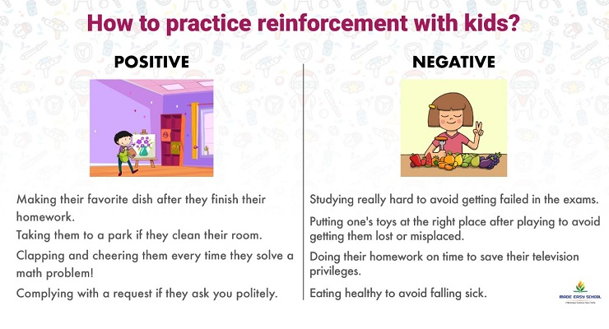

Slide 29
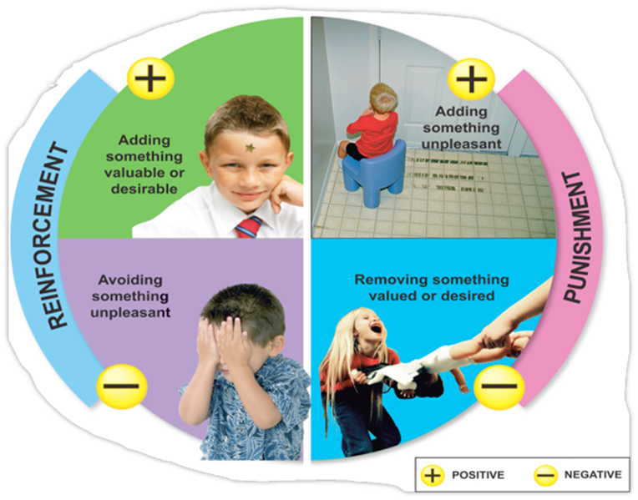

Slide 30
Punishment, is the presentation of an adverse event or outcome that causes a decrease in the behavior it follows. (Positive Punishment, Negative Punishment)
In both of these cases of punishment, the behavior decreases.

Slide 31
Positive punishment
Negative punishment
Positive punishment sometimes referred to as punishment by application, involves the presentation of an unfavorable event or outcome in order to weaken the response it follows.
For example: 1. An employee exhibits bad behavior at work and the boss criticizes him. The behavior will decrease because of the boss’s criticism.
2. In an experiment, the subject received a slight electric shock when they got an answer wrong.
Negative punishment, also known as punishment by removal, occurs when an favorable event or outcome is removed after a behavior occurs.
For example: 1. Taking the student's phone or tablet because of improper use during the class
2. A third-grade boy yells at another student during class, so his teacher takes away "good behavior" tokens that can be redeemed for prizes.

Slide 32
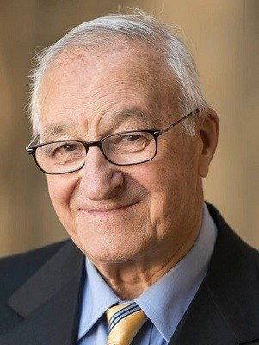
III. Observational Learning/Social Learning theory
Albert Bandura OC was a Canadian-American Psychologist
Observational learning is a process in which learning occurs through observing and imitating others.
Replicating others’ novel behavior through observation and imitation; also known as vicarious learning, modeling, or social learning.
Social learning theory considers how both environmental and cognitive factors interact to influence human learning and behavior
It is based on the principle of modifying or adopting new behavior after observing another individual performing it.

Slide 33
Cont.
Individuals that are observed are called models.
The observer will either perform or avoid the behavior based on the consequence the model received after doing the behavior.
In society, children are surrounded by many influential models, such as parents within the family, characters on children’s TV, friends within their peer group and teachers at school.
For Example: Hennry learns not to jump on the coffee table, because he watched his brother get into trouble for doing so last week.

Slide 34
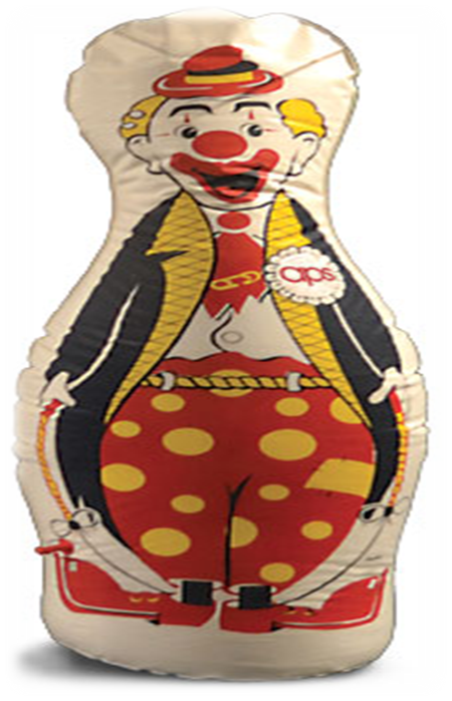
Bobo Doll Experiment (Albert Bandura, 1961) A study of aggression
Albert Bandura (1961) conducted a controlled experiment study to investigate if social behaviors (i.e., aggression) can be acquired by observation and imitation
Albert Bandura let a group of kindergarteners watch a film of an adult violently attacking an inflatable plastic toy shaped like Bobo the Clown, by hitting it, sitting on it, hammering it, and so forth.
He then let the children into a room with Bobo dolls.
The children precisely imitated the adult’s behavior, excitedly attacking Bobo doll.
Their behavior was a type of observational learning
Notes:
https://www.simplypsychology.org/bandura.html

Slide 35
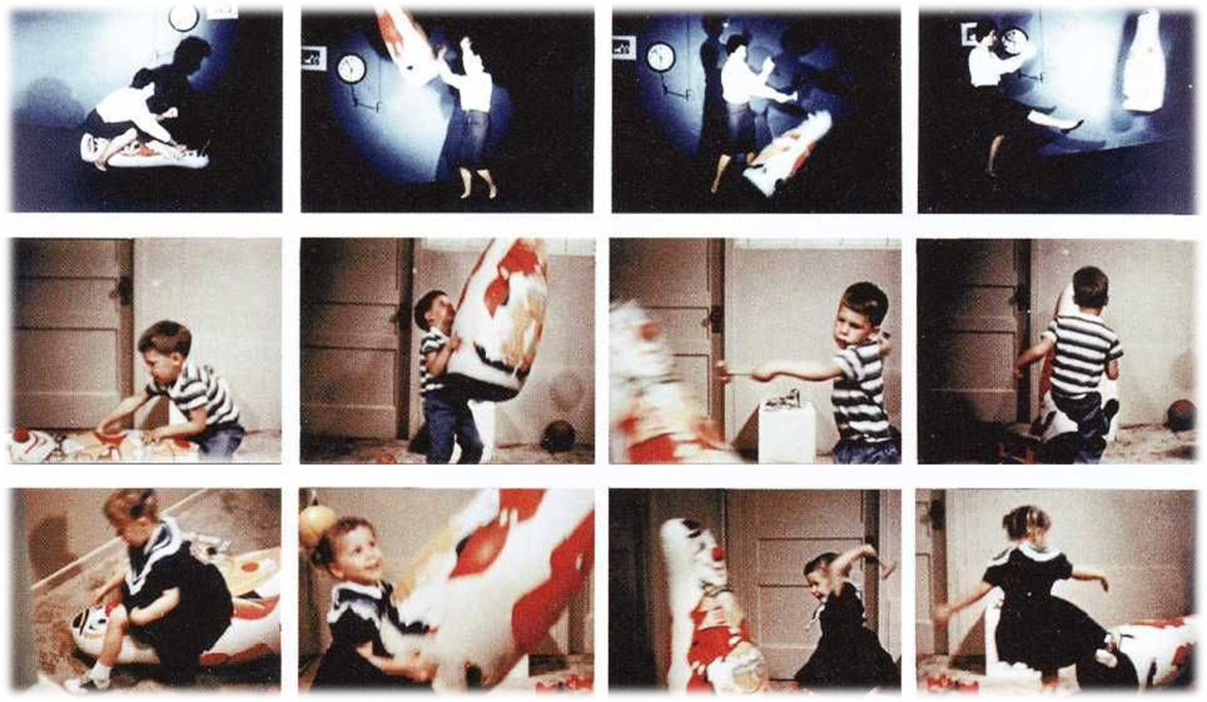

Slide 36


Slide 37
THE BOBO DOLL EXPERIEMENT BY BANDURA
https://www.youtube.com/watch?v=eqNaLerMNOE
Aggression is a learned behavior.

Slide 38
LIST OF REINFORCEMENTS (Examples)
Praise and nonverbal communication (e.g., smile, nod, thumbs up)
social attention (e.g., a conversation, special time with the teacher or a peer)
tangibles such as stickers, new pencils or washable tattoos
activities or privileges such as playing a game, sitting in a special place in the class, drawing, writing, coloring, going to recess or gym early, having extra computer time
secondary positive reinforcements (such as checkmarks, tokens or money) for students to accumulate in order to acquire tangibles or be allowed to participate in special activities.

Slide 39
LIST OF PUNISHMENTS (Examples )
Yelling – scolding, name calling, demanding
Withdrawing or Withholding – taking away privileges which may or may not have anything to do with their unacceptable behavior
Grounding – not allowing them to do anything but what is (according to the parents) necessary
Isolation – giving them “time outs”, alone and away from everyone else

Slide 40
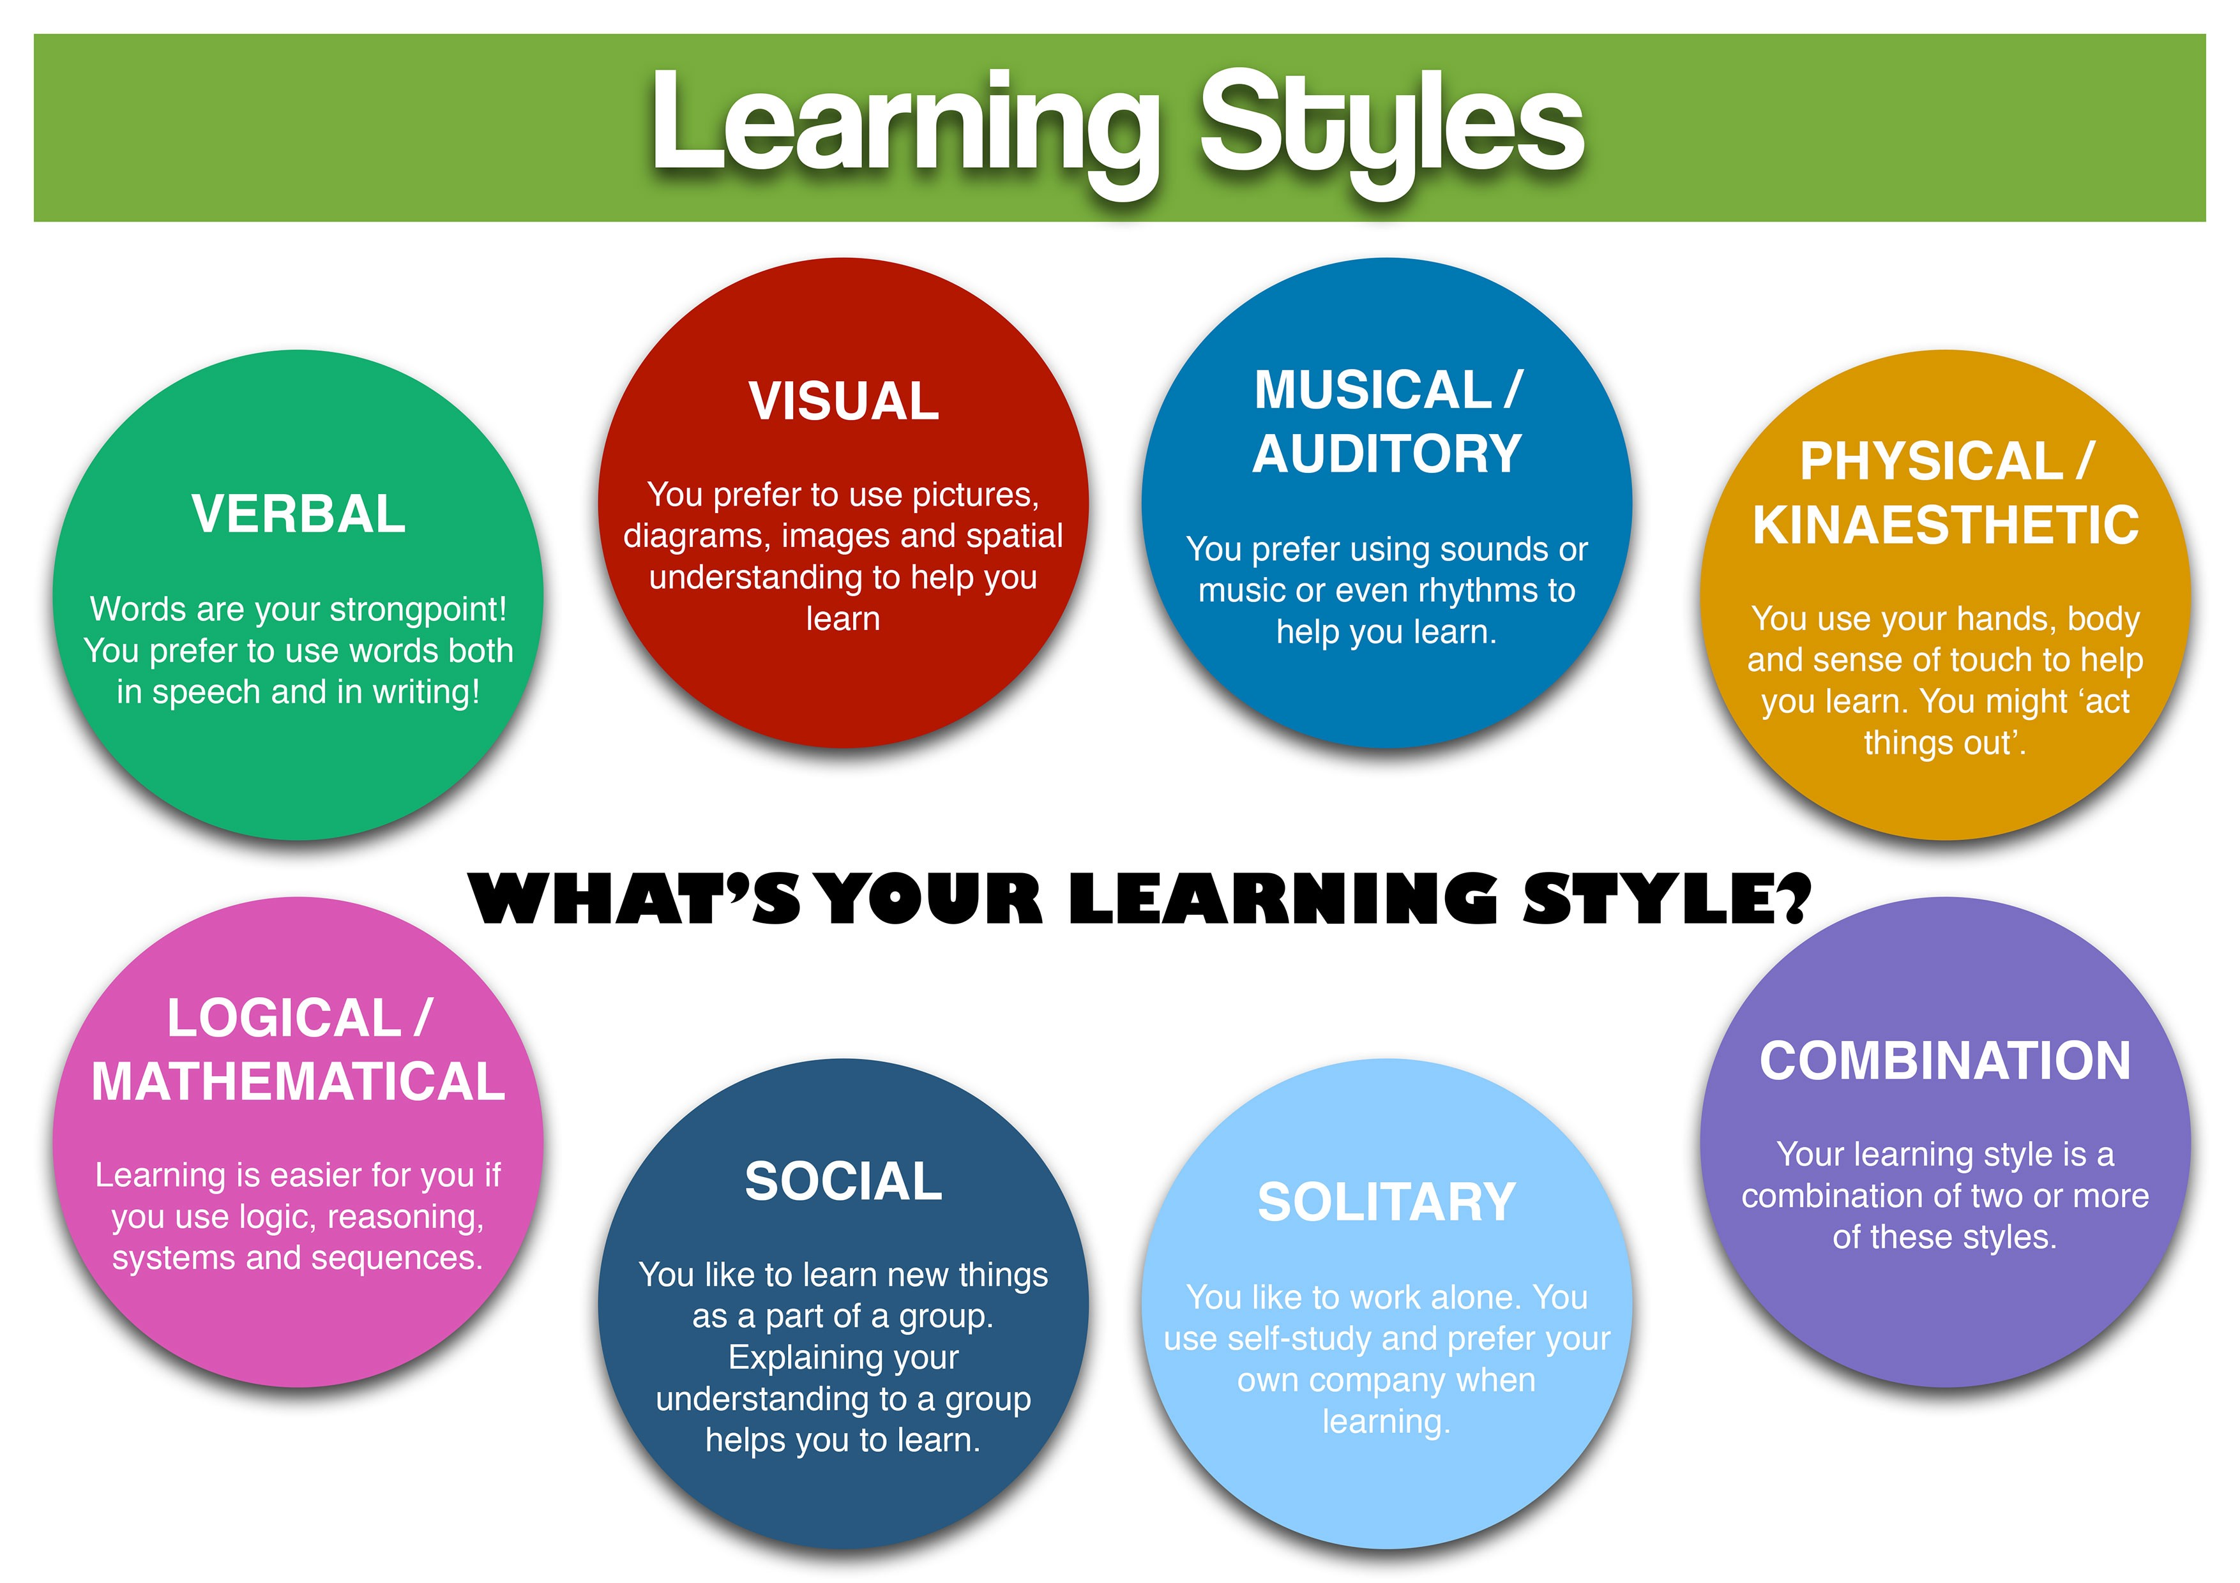
Learning Styles

Slide 41


